Slide 1
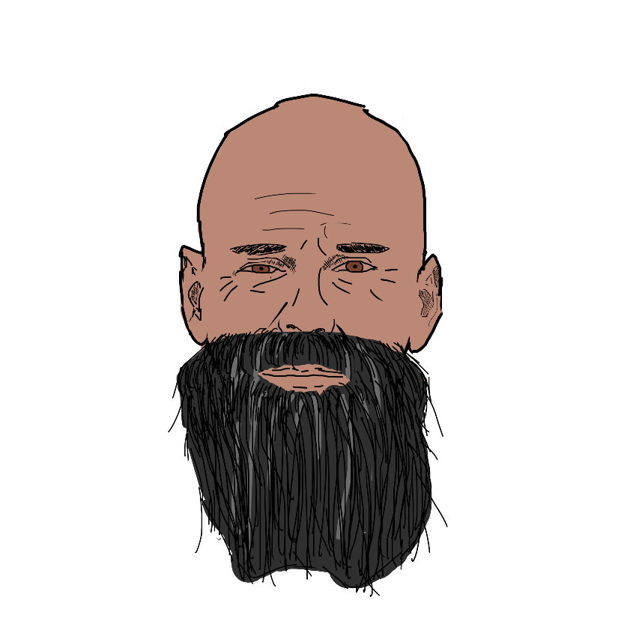
PROTO-PERSONA
Name: Bruhe
Role: Old
Personality Traits:
Grouchy,
Old,
Gruff,
Passion for the unknown
Ideals:
Sleep,
Eating,
Discovering the unknown
Other:
Can be rude,
Does not care about other people generally
Needs: Adventure & Discovery
Obstacles: Age
Accessibility: Bruhe’s eyes are starting to fail so the site should have semantically correct html so that text to speech functions can work optimally.

Slide 2
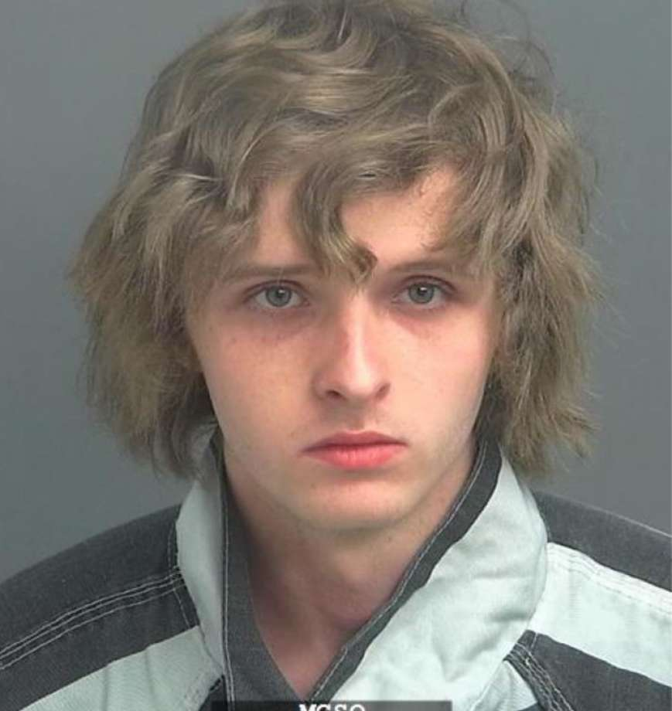
Name: Trevor Description: 22 years old, unemployed
“B52 shots are the bomb!”
Lazy Bum
Good at computers
Graduated Highschool
Personal Profile
Son of a rich family which means he has never had to work for money or really worry about anything in life. This has made him into an idle internet troll with an alcohol addiction. Sometimes plays online games but usually prefers to browse random websites to find something interesting. He has gone through many computers due to unintentionally downloading viruses from some shady sites.
Personal Information
Profession: Unemployed
Location: London
Age: 22
Hobbies: Drinking, wasting time on stupid websites
Favourite TV Show: Castlevania
Personality: Rude, Bored, Easily Entertained
Internet usage
Internet experience: Causal
Primary Uses: Browsing random sites
Favourite Sites: News sites, Netflix, Youtube
Hours online per week: 25
Computer: Newish
Study information
Current qualifications: Barely passed high school
Literacy: English
IT Skills/knowledge: Pretty Good
User Goals Trevor frequents TheOnion because: He finds the shear ridiculousness of the satirical news articles funny Like to show his technologically incompetent grandparents random articles to freak them out. | Business Objectives We want Trevor to: Spend his parents money on the premium membership. Revisit the site to consume more fake news Tell his friends about the website.

Slide 3
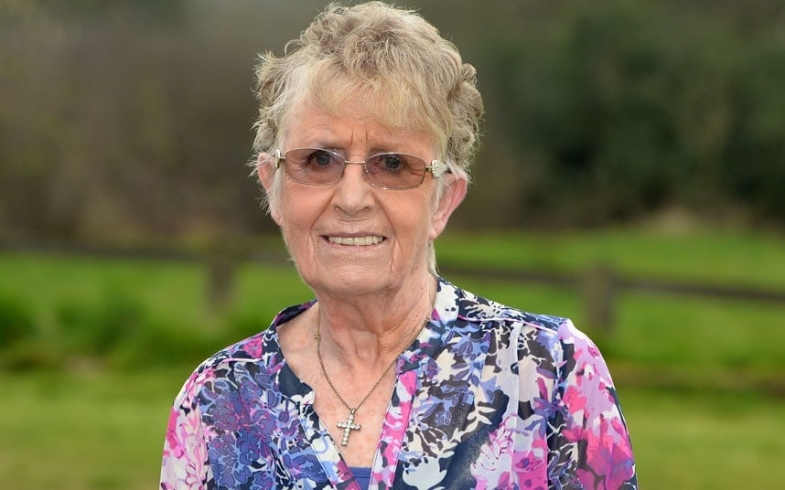
Name: Tris Description: 69 years old, Works in the textile industry.
“Do What is Hard, Embrace High Expectations, Do Work that Matters.”
Is very good at sewing
Computer Novice
Graduated University
Personal Profile
Tris was born into a relatively poor family and has had to work hard most her life to get what she wants. Today she is 69 but still going strong, working 4 days a week in a textile factory. She graduated university at age 22 with a fashion degree before going through many jobs. Tris has had a busy but fulfilling life.
Personal Information
Profession: Seamstress
Location: New Zealand
Age: 69
Hobbies: Knitting, Sewing, Gossip
Favourite TV Show: Great British Bake-Off
Personality: Straightforward, Blunt
Internet usage
Internet experience: Very little
Primary Uses: Searching for sewing supplies.
Favourite Sites: joann.com
Hours online per week: 3
Computer: Old 2000s Office Desktop
Study information
Current qualifications: Bachelors in Fashion
Literacy: English
IT Skills/knowledge: How to Browse the internet.
User Goals Uses the internet purely for practical reasons, rarely uses technology for enjoyment. Like to order fabric and sewing materials online. Every now and then Tris will check some random news sites to stay up to date with the world. | Business Objectives We want Tris to: Be able to use the site comfortably. Like the news on the site enough to spend her hard earned money on a membership. Revisit the site to consume more news.

